Slide 1


ICT Training
Start
Notes:
DO: Display the slide till participants are settling.
Enter and Go on next slide and continue

Slide 2

Fundamentals of ICT in Educational Contexts
Welcome
Notes:
Speaker: "Good morning, everyone! I welcome you all.
I hope you're all are doing well. Today we are gathered here for a training on ICT (Information and Communication Technology in education.)
DO: I'm [Your Name], and some more introduction.
Let's begin our first session which is on ‘Fundamentals of ICT in Educational Contexts.’ Today, we aim to lay a solid foundation for understanding how ICT can transform our teaching and learning environments. We'll start by discussing what ICT is and why it's so crucial in today's educational landscape.
DO: Go on next slide and continue

Slide 3

Focus Areas in Today’s Session
Explore a variety of ICT tools and resources.
Learn to enhance teaching effectiveness and student engagement.
Discover methods to integrate these tools into daily teaching practices for more interactive and impactful learning.
Gain skills in accessing and utilizing educational platforms.
Learn to use QR codes for easy access to online resources.
Practical demonstrations on using key platforms like MIS Monitoring Tool, NCERT, DIKSHA and Shiksha Portal.
Notes:
Speaker: In this session, "You'll be introduced to a variety of ICT tools and resources that can significantly enhance both teaching effectiveness and student engagement. We'll explore how these tools can be integrated into your daily teaching practices, making learning more interactive and impactful.
Pause
Speaker: "A key part of today's session involves navigating and utilizing educational platforms. We'll learn how to access valuable resources from both government and private educational websites using simple tools like QR codes. I'll demonstrate how to use platforms such as the NCERT and Shiksha Portal, ensuring you gain practical understanding and hands-on experience.
Take small pause
Speaker: "Remember, this session is interactive, so I encourage you all to ask questions, share your insights, and engage in discussions as we go along. Your active participation will enrich our learning experience.
So, to break silence and encourage your participation, let me ask, how I did your welcome?
DO: Ask a few participant to answer one by one (Mostly will remember clap)
Speaker: Then say, see this is the power of ICT, this help us to remember things in better way and for longer time. This is just a basic example, in session we will unfold more on this.
So, without further delay, let’s move on this exciting learning journey together.
Welcome to Session 1: Fundamentals of ICT in Educational Contexts."
DO: Go on next slide and continue

Slide 4

Basics of ICT- Information and Communication Technology
Notes:
Speaker: ICT stands for Information and Communication Technology, and it's the infrastructure and components that enable modern computing."
DO: Go on next slide and continue

Slide 5

Basics of ICT- Information and Communication Technology
Hardware
Software
Networks
Database
Notes:
Speaker: Speaker: "The foundation of ICT is built upon four pillars: hardware, which is the physical component of technology; software, the programs and applications that run on hardware; networks, which allow computers to communicate and share resources; and databases, which store and organize data."
Speaker:
"Now, I want you to think about the devices you use daily.
DO: Let participants give 5 minutes to reflect on these daily tools.
ASK: How these tools help in their work and are they happy that that they started using it.
(Main idea: It is just to convey new techniques are helpful)
DO: Go on next slide and continue

Slide 6
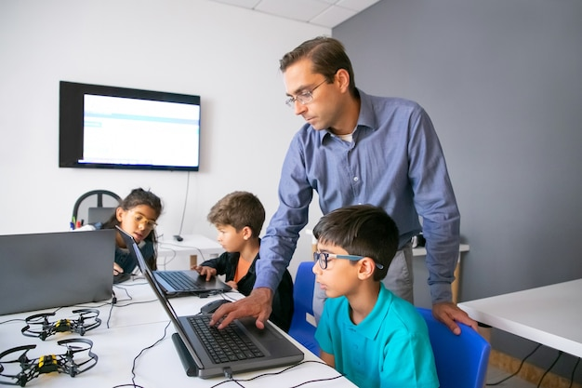
Basic Communication Tools
Notes:
Continue with previous
Speaker:
While you may or may not have personal computers, the concepts of ICT can still be applied through shared community resources, like a village computer center or school technology or computer labs."
DO: Go on next slide and continue

Slide 7


Basic Communication Tools
Notes:
Continue with previous
Speaker:
So, all of you have used a basic mobile phone to send a text message or make a call? Or listened to the radio for news and information?“ These tools are the building blocks of ICT. They represent the beginning of a journey into a wider digital world.
DO: Go on next slide and continue

Slide 8

Importance of ICT
Notes:
Speaker:
Before moving ahead, here lets first discuss the significance of ICT. As we all are human beings, it won’t interest us, till we are not sure of benefits. (Say in humorous tone)
We know learning is most effective when it engages multiple senses.
Look at this video.
DO: Click on play button.
ICT tools can stimulate visual, and auditory learning through interactive videos.
This multi-sensory approach caters to diverse learning styles and needs, making education more inclusive and effective. When we teach our students teaching become more interesting and students take more interest as they understand concepts in better way.
DO: Go on next slide and continue

Slide 9


Importance of ICT
Notes:
Speaker: ICT opens up a vast array of educational resources that were previously not in access. Teachers and students can access up-to-date information, research, and global perspectives, enriching the learning experience and fostering a more informed and connected classroom.

Slide 10

Importance of ICT
Notes:
Speaker: In an increasingly digitalized world, proficiency in ICT is not just an academic requirement but a vital life skill. Training teachers in ICT equips them to prepare students for the realities of the modern workforce and society, where digital literacy is paramount.

Slide 11
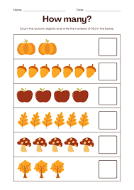
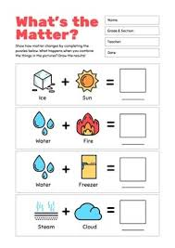

Importance of ICT
Notes:
Speaker: ICT tools enable more efficient and varied forms of assessment. Teachers can access ready worksheets and save on time . Digital quizzes, online assessments, and interactive learning platforms provide immediate feedback, helping both teachers and students track progress and understand areas for improvement.
Therefore, ICT training is crucial as it not only aligns with the multi-sensory nature of learning but also enhances the overall educational experience. It prepares both educators and students for a future where technology plays a central role in how we communicate, learn, and work.
DO: Ask participants, if they understood, why they are attending ICT training.

Slide 12
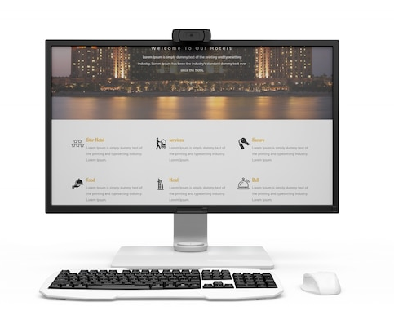


ICT Tools and Resources
Google Suite
Teacher’s System
Notes:
Speaker: If you are very clear with the importance of ICT, I will take it forward so that, we can have maximum benefit out of it.
Now, we will discuss how you can take maximum benefit of the resources present in your own school.
Each school is equipped with a teacher system – that's your command center. From here, you can access the Google Suite with tools like Google Classroom, Docs, and Slides to create and share educational material."

Slide 13

ICT Tools and Resources
Student’s System
Notes:
Speaker:
Our students have access to student systems. These computers are invaluable for hands-on learning, from research projects to computer science education, and for fostering digital literacy."

Slide 14
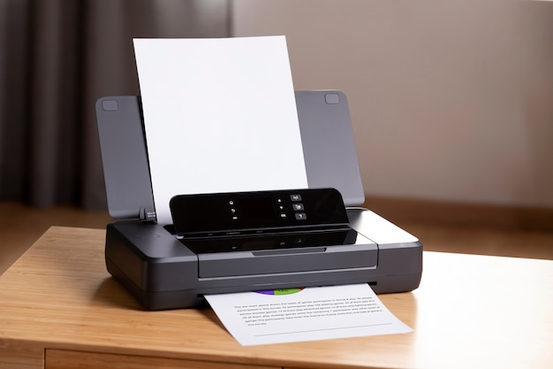
ICT Tools and Resources
Printer-an ICT tool
Notes:
Speaker: You also have access to the multi-functional printer, which is not just for printing documents. It can scan and copy, allowing us to share students' work and create a paper trail for important projects and artwork."

Slide 15

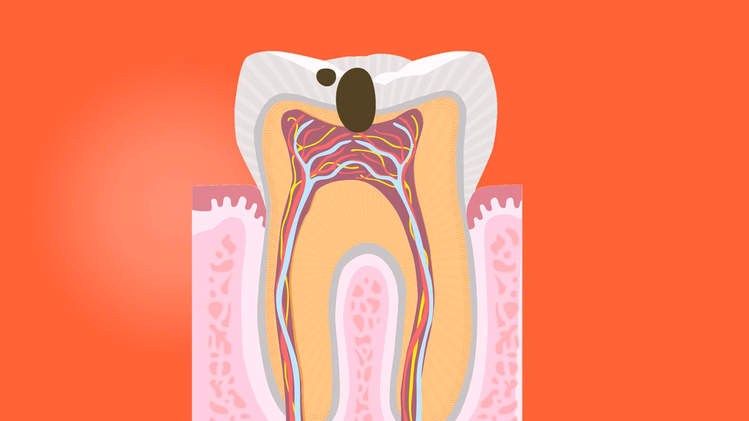
ICT Tools and Resources
Notes:
Speaker: One of the gems of our ICT setup is the Smart TV. It's a versatile tool that can be used to stream educational videos, display student presentations, or even connect to a computer for interactive lessons.“
Do: Let the video play and then move to next slide.
Ask: Did you like the video, see how things are easy to understand when we can see them other than just reading and assuming the things.

Slide 16
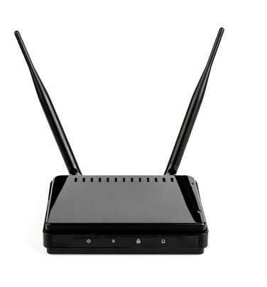
ICT Tools and Resources
Wi-Fi Router
Notes:
Speaker: Now, all these tools will work, if you will ensue that your WI-FI router is plugged In. It is important to have access to the internet to use resources available online.

Slide 17
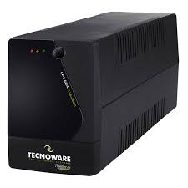
ICT Tools and Resources
Wi-Fi Router
UPS – Uninterrupted Power Supply
Notes:
Speaker: To solve the problem of power interruptions, thanks to our UPS tool which is like a feather in ICT tools. UPS stands for Uninterrupted power supply . This unit will keep critical systems running smoothly even when there are outages, ensuring that your lesson can go on."

Slide 18
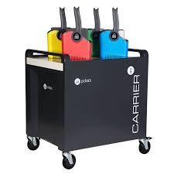
ICT Tools and Resources
Charging Trolley
Notes:
Speaker: In our schools we also have facility of charging trolleys.
It is a mobile power solution, ensuring all our devices are charged and ready to go for each lesson."
All these elements together create an integrated, interactive, and engaging learning environment for our students.
Hope all of you are now well-versed with the tools you have with you. I encourage you to share your queries, if any.

Slide 19
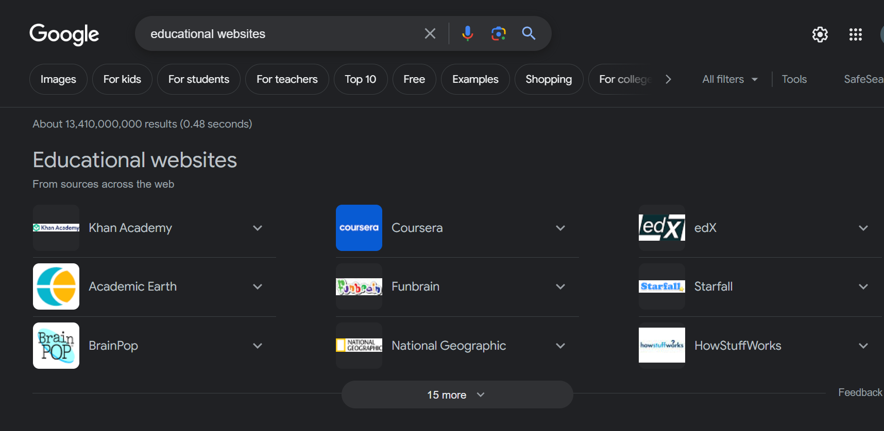
ICT Tools and Resources
Tools and Resources
Notes:
Speaker: Now, you know you can give better learning experience to students, using ICT tools. Let me share how you can access to educational websites using web links or QR codes.

Slide 20

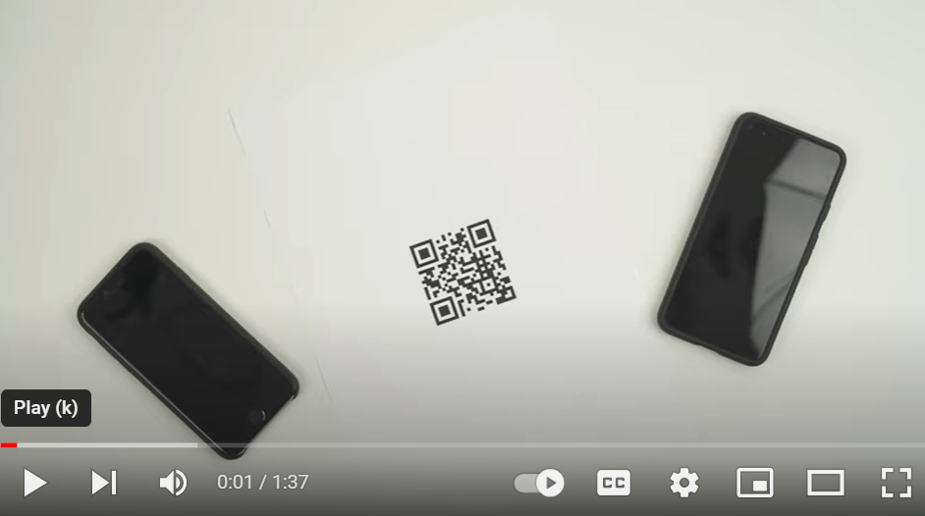
ICT Tools and Resources
QR code
or
Quick Response code
Play me
Notes:
Speaker:A QR code, or Quick Response code, can be scanned using the camera of a smart device like a tablet or smartphone, or even using the webcam of your student systems.“
I will show you in detail how to scan a QR Code, with the help of this video.
DO: Press CTRL+Click to play the video (Skip the ad)

Slide 21
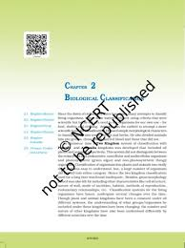
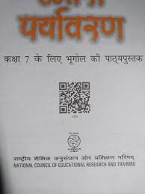

ICT Tools and Resources
Notes:
Speaker: You can easily scan QR codes given on NCERT or other books.
Speaker: "I suggest you to create a collection of QR codes for the educational resources you find most valuable. You can print these out and post them in your classroom for easy student access, or include them in your lesson plans and handouts."
NOTE: Next slide is an optional activity. If tile allows, can do it or skip the slide, by clicking twice.

Slide 22
ICT Tools and Resources
Hands-On Activity – Scanning QR Code
Notes:
Speaker: Let’s try scanning QR Code. Please remove your devices/ mobile phones for the activity who are willing to do it and have internet in the phones.
"First, you'll need a QR code scanner app. Many devices have this feature built-in, but there are also free apps available for download. Once you have your app ready, open it and point your device’s camera at the QR code."
DO: Pauses to allow participants to follow along
Speaker: "After scanning, a notification will appear with a link. Tap on it, and it will take you directly to the website. It’s that simple!"
DO: Ensures everyone is able to scan and access the link.
Option 2
"To make this more engaging, let’s have a QR code scavenger hunt. I’ve placed several QR codes around the room, each linking to different educational resources. Your task is to find and scan each one, and write down what resource it leads to. Ready? Go!"
DO: Ensures everyone is able to scan and access the link.
Once they are done
Say: Great, you have learnt it quickly.

Slide 23
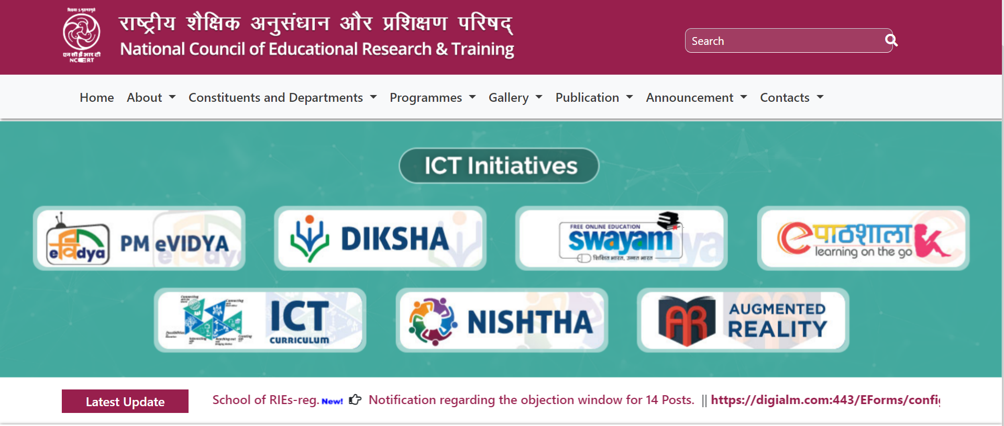
ICT Tools and Resources
Notes:
Speaker: These are different initiatives under NCERT…..

Slide 24
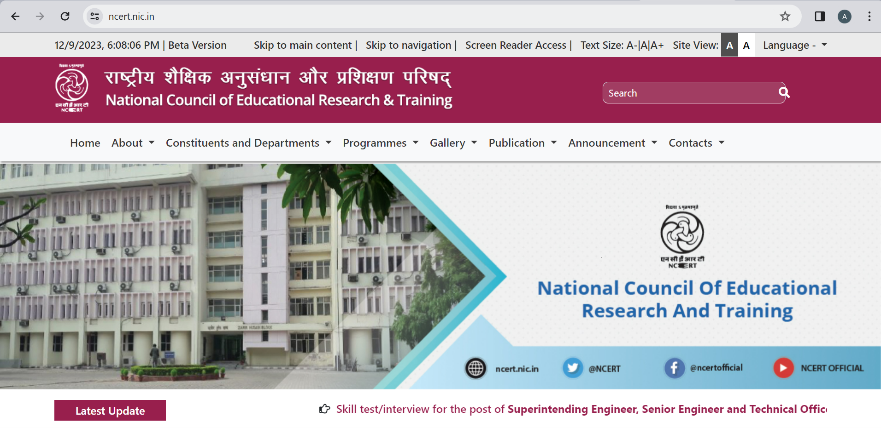
ICT tools and Resources
Notes:
Speaker: "Apart from the convenience of QR codes, we have access to comprehensive educational platforms like the NCERT…….

Slide 25

ICT Tools and Resources
Notes:
Speaker: "The NCERT, or National Council of Educational Research and Training, provides a wide array of resources. From textbooks to supplementary materials and interactive lessons, it's a resource that aligns with our national curriculum standards."

Slide 26

ICT Tools and Resources
Notes:
Speaker: Another we have Shiksha Portal. It also offers a range of educational services, including lesson plans, teaching aids, and professional development resources that are both innovative and practical for our classroom use."
These platforms are a treasure (Use word Khazana too) of information and learning materials, that can greatly benefit our teaching methods and our students' learning experience.“
NOTE: NEXT slide is optional

Slide 27
ICT Tools and Resources
Click Me
Notes:
Speaker: "Now, let’s take a moment to explore the platform and find the material for the subjects you teach.
Ask: Ask participants what they want to see on website.
DO: Show 2-3 things as per their choice.
Note: Click on the “Click Me” to go directly go to website. Spend 5-10 minutes and give a walkthrough.

Slide 28
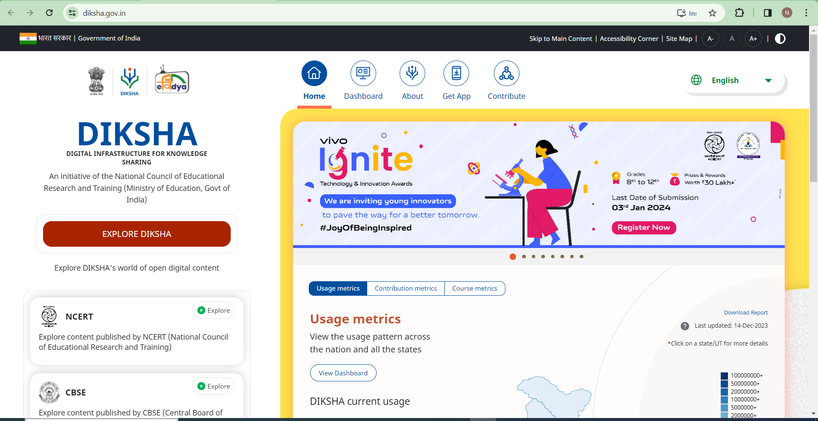
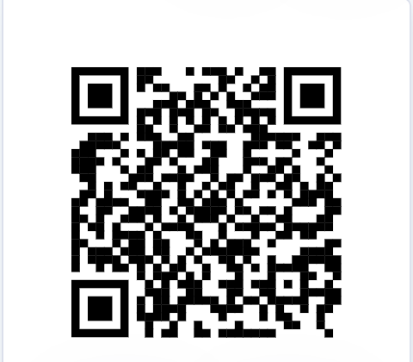
ICT Tools and Resources
Download the app by Scanning QR Code
Notes:
Speaker: Similarly, we also have DIKSHA Portal, an initiative by government for Digital Education in India. It enhances solutions within the field of teacher education. The DIKSHA platform provides learning materials aligned to our subjective curriculum for teachers, students, and parents.
Activity - Simply download the DIKSHA app and scan QR codes in your textbooks to conveniently access all your lessons.
NOTE: NEXT slide is optional

Slide 29
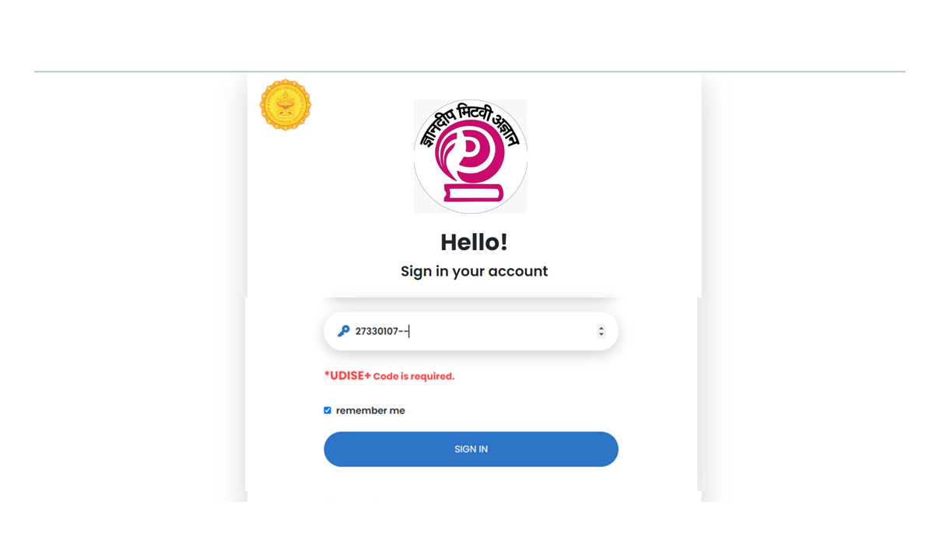
ICT Tools and Resources
Click Me
Notes:
Speaker: Allow me to introduce you all to The MIS Monitoring Tool, you can simply login with School’s UDISE+ code and refer to the digital resource's links available for teaching and non-teaching staff. It provides links to pre-loaded e-content, e-textbooks, audio-videos, educational portals like DIKSHA, NCERT, and many more.
Note: Add the MIS Monitoring Tool link to “Click Me” button to go directly go to the tool. Spend 5-10 minutes and give a walkthrough.

Slide 30

Notes:
Speaker:
I hope all of you are taking out some new things from today’s training. This training will benefit if these will be regular use of these ICT tools.
Next, I want you to think about how you can schedule regular visits to the computer lab to make the best use of these platforms. Draft a weekly plan that incorporates lab time into your existing syllabus."
"Remember, the goal is to integrate ICT into your teaching in a way that is seamless and beneficial. Whether it's through accessing digital textbooks on the NCERT portal or utilizing other interactive tools.
Finally, I must say, you are doing best with your work and these resources are here to enhance your teaching and your students' learning."

Slide 31

Notes:
Speaker: Thank You everyone for your time.

